Slide 1
Growth & Allocation
March 19, 2019

Slide 2
Spicoli question of the day: Why do plants grow?

Slide 3
Allocation

Slide 4
Allocation
The distribution of growth to different organs
Allometry: the relative size of different organs
High leaf allocation
High stem allocation

Slide 5
Following the carbon

Slide 6
CO₂
Carbon is first taken up by photosynthesis (source)

Slide 7
The sugars are then transported throughout the plant (sinks)

Slide 8
Sucrose, not glucose, is the primary transport sugar…huh?
Sucrose
Glucose
Notes:
Aldehyde group of glucose is easily oxidized (reacts with others) and is also attracted to enzymes

Slide 9
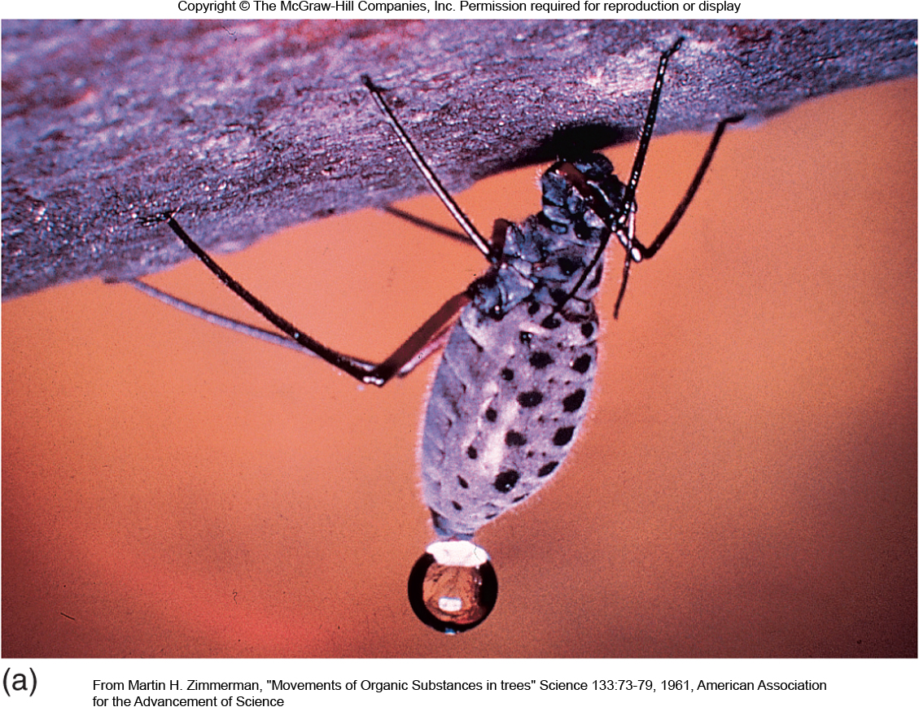
Translocation
Movement of food substances through the plant (via water)
Translocation happens fast!
(Can’t be accounted for by diffusion alone)

Slide 10
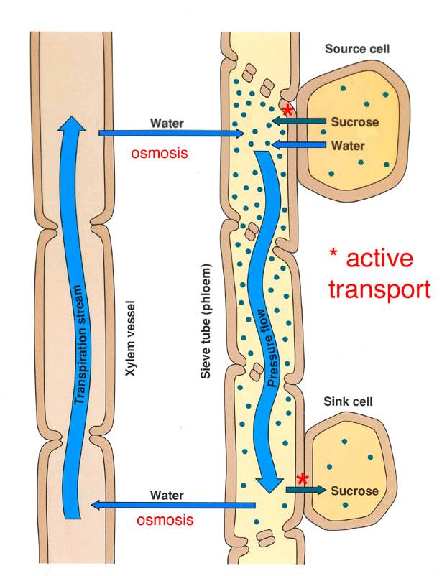
Pressure-flow hypothesis
Food is actively loaded into phloem from “source”
Water enters phloem from xylem via osmosis
Pressure gradient drives food to “sink”
Food is actively removed from sink

Slide 11
What do the sugars from photosynthesis get used for? (What are the sinks?)

Slide 12
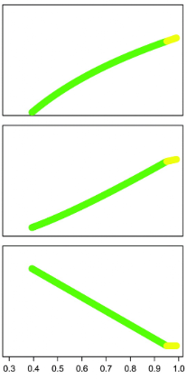
Allocation is a dynamic process that is dependent on the environment
Leaves
Stems
Roots
Environmental change
Farrior et al. (2013)

Slide 13
In isolation, how would abiotic conditions influence allocation?
Light
Temperature
Water
CO₂
Nutrients
NASA

Slide 14
In isolation, how would life history traits influence allocation?
Lifespan
Ontogeny
Photosynthetic pathway
Microbial symbiosis

Slide 15
Class activity: the Invader
Pretend you are a species of plant
Dr. Smith will give you a place to invade
What growth and reproductive strategy will you adopt?
What would your allocation pattern be like?
Things to think about:
What is the environment like?
Natural enemies?
Competitors?
What kind of flowers/seeds?

Slide 16
Joshua Tree NP (CA)
Big Bend NP (TX)
Congaree NP (SC)
Everglades NP (FL)
Smokey Mtns NP (TN)
Badlands NP (SD)
Rocky Mountain NP (CO)
Sequoia NP (CA)
Acadia NP (ME)

Slide 17
Source/sink controversy

Slide 18
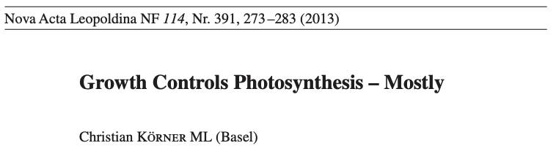

Slide 19
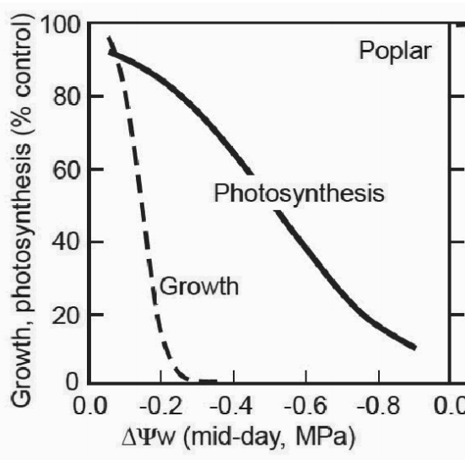
Water availability constrains growth more than photosynthesis
Körner (2003)

Slide 20
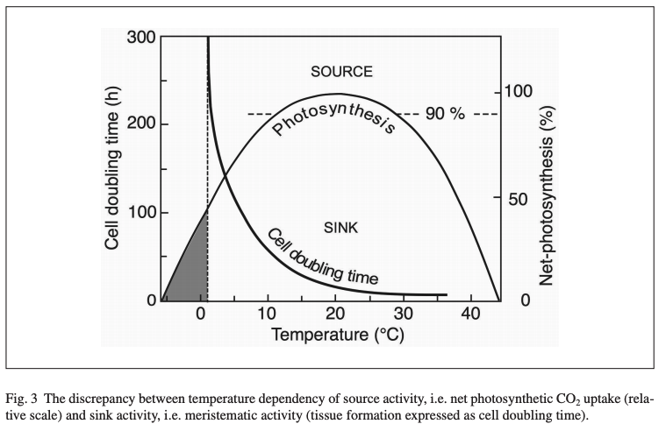
Low temperature constrains growth more than photosynthesis
Körner (2003)

Slide 21
So under low resource availability, we might expect low growth to result in reduced photosynthesis, as more photosynthesis would be wasteful

Slide 22
Overarching thesis – photosynthesis matches sink strength

Slide 23
Overarching thesis – photosynthesis matches sink strength
How could you test this??

Slide 24
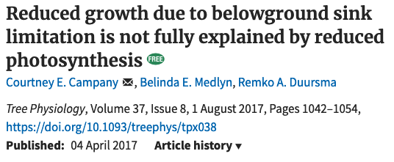

Slide 25
Plant growth decreased by 84%
Campany et al. (2017)

Slide 26
Allocation was similar
Campany et al. (2017)

Slide 27
Photosynthesis only decreased by 26%, but there was a big change in carbon use efficiency
Growth per whole-plant photosynthesis
Campany et al. (2017)

Slide 28
Conclusion: sink strength does influence photosynthesis, but this does not fully explain sink-limited growth reductions

Slide 29
Some things that need considered
Photosynthetic acclimation
Whole-plant- versus leaf-level photosynthesis
Within-leaf and whole-plant allocation of nutrients

